Slide 1
How to make a sunflower collage
By Artsmark Ambassador Millie

Slide 2
Equipment
You will need:
. A-3 paper or newspaper
. Yellow and orange paper
. Silver, green and yellow pens
. Glue
. Two tea bags
. Cup to draw round
. Pencil

Slide 3
Method
. First get your cup and draw two circles one 3-5 cm higher than the other
. Next get your pencil and draw a stem down from each stem and colour it green
. Then get your yellow paper and cut out petal shapes about 1-1 and a half cm long
. Stick the petals around the circles
. Then do the same with the orange paper
. Next get the glue and cover the circle in it
. Rip the tea bag and sprinkle some tea over the glue, make sure the tea covers the entire circle
. Next draw an oval next to the tallest flower and put yellow and black stripes on it
. Draw a heart shape on the top of the oval and add a smiley face and swirly trail behind the bee
. Colour in the wings silver and you are done

Slide 4
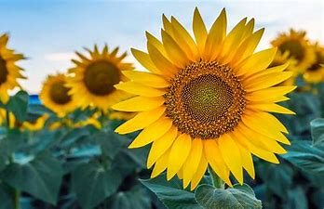
Have Fun

